Slide 1
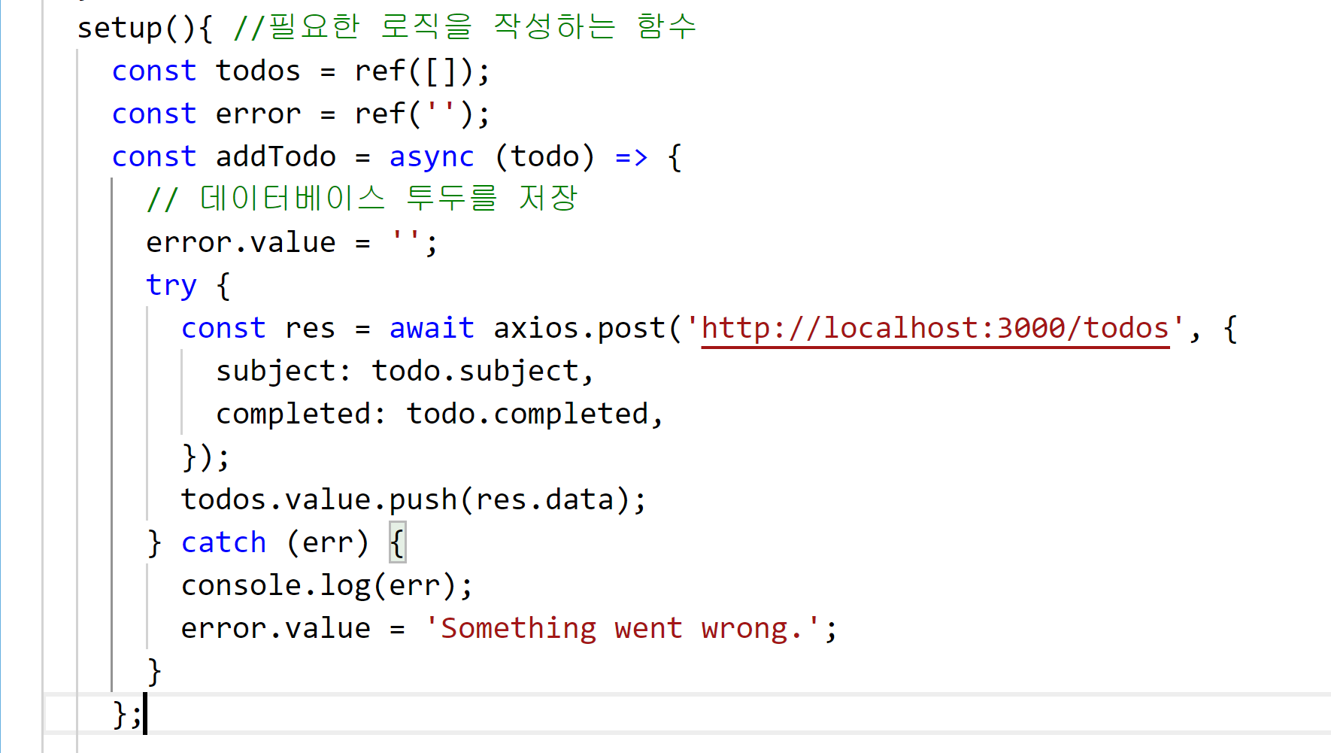
28.async/await : https://github.com/kossiecoder/vue3-basic/blob/28/src/App.vue

